Slide 1
Laboratory Earthquake Analysis
Daniel Davieau, Olga Tanyuk

Slide 2
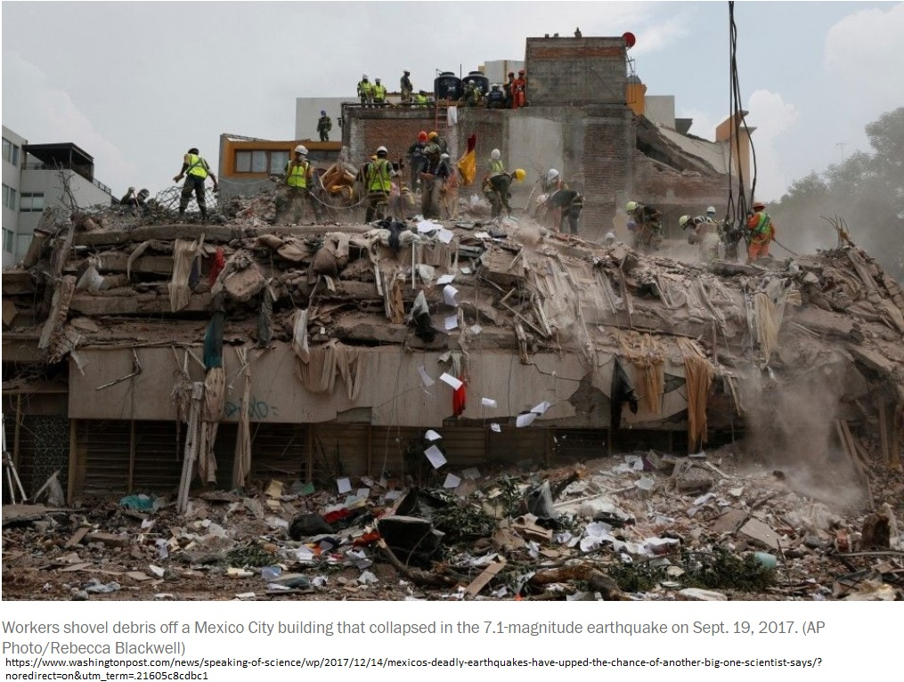
Regular Earthquakes
Catastrophic Stick–Slip Failure Events
Stress builds between tectonic plates gradually
Stress eventually overcomes friction
Slip occurs releasing high-frequency seismic energy

Slide 3
Classical Earthquake Forecasting
Based on the recurrence interval of earthquakes that repeat periodically
Margin of error can span decades
“Similar earthquakes occurring between 1857 and 1966 suggested a recurrence interval of 21.9±3.1 years, and thus, an earthquake was expected between 1988 and 1993, but ultimately took place in 2004”

Slide 4
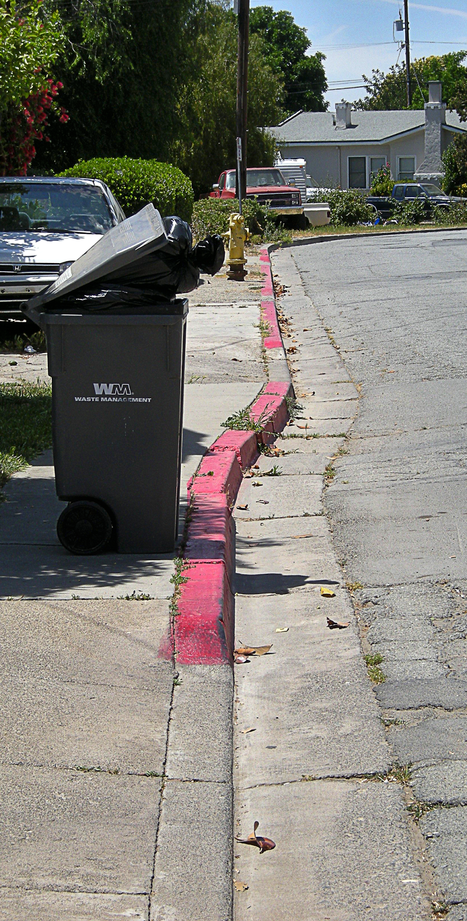
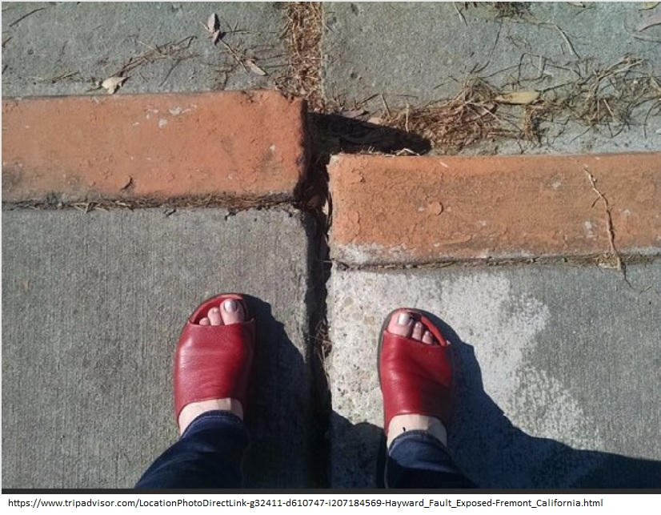
Slow Slip Earthquakes
Slow Slip Earthquakes:
Occur very slowly
Are undetectable without instrumentation
Do not reach rates sufficient to radiate high-frequency seismic energy
Image from http://www.rocdoctravel.com

Slide 5
Regular and Slow Slip
Relationship between Slow Slip and Regular Earthquakes?
Evidence suggests that there is a relationship between slow slip earthquakes regular earthquakes.(Baptiste Rousset, Roland Burgmann)
May play a role in stress transfer and triggering of regular earthquakes

Slide 6
LANL Predicts Laboratory Earthquakes
Los Alamos National Laboratory (LANL) predicted laboratory earthquakes with 89% accuracy
“We show that by listening to the acoustic signal emitted by a laboratory fault, machine learning can predict the time remaining before it fails with great accuracy”
- Rouet-Leduc Bertrand, Hulbert Claudia, Lubbers Nicholas, Barros Kipton, Humphreys Colin J., JohnsonPaul A. (2017, July 15). Machine Learning Predicts Laboratory Earthquakes. Retrieved from https://doi.org/10.1002/2017GL074677

Slide 7
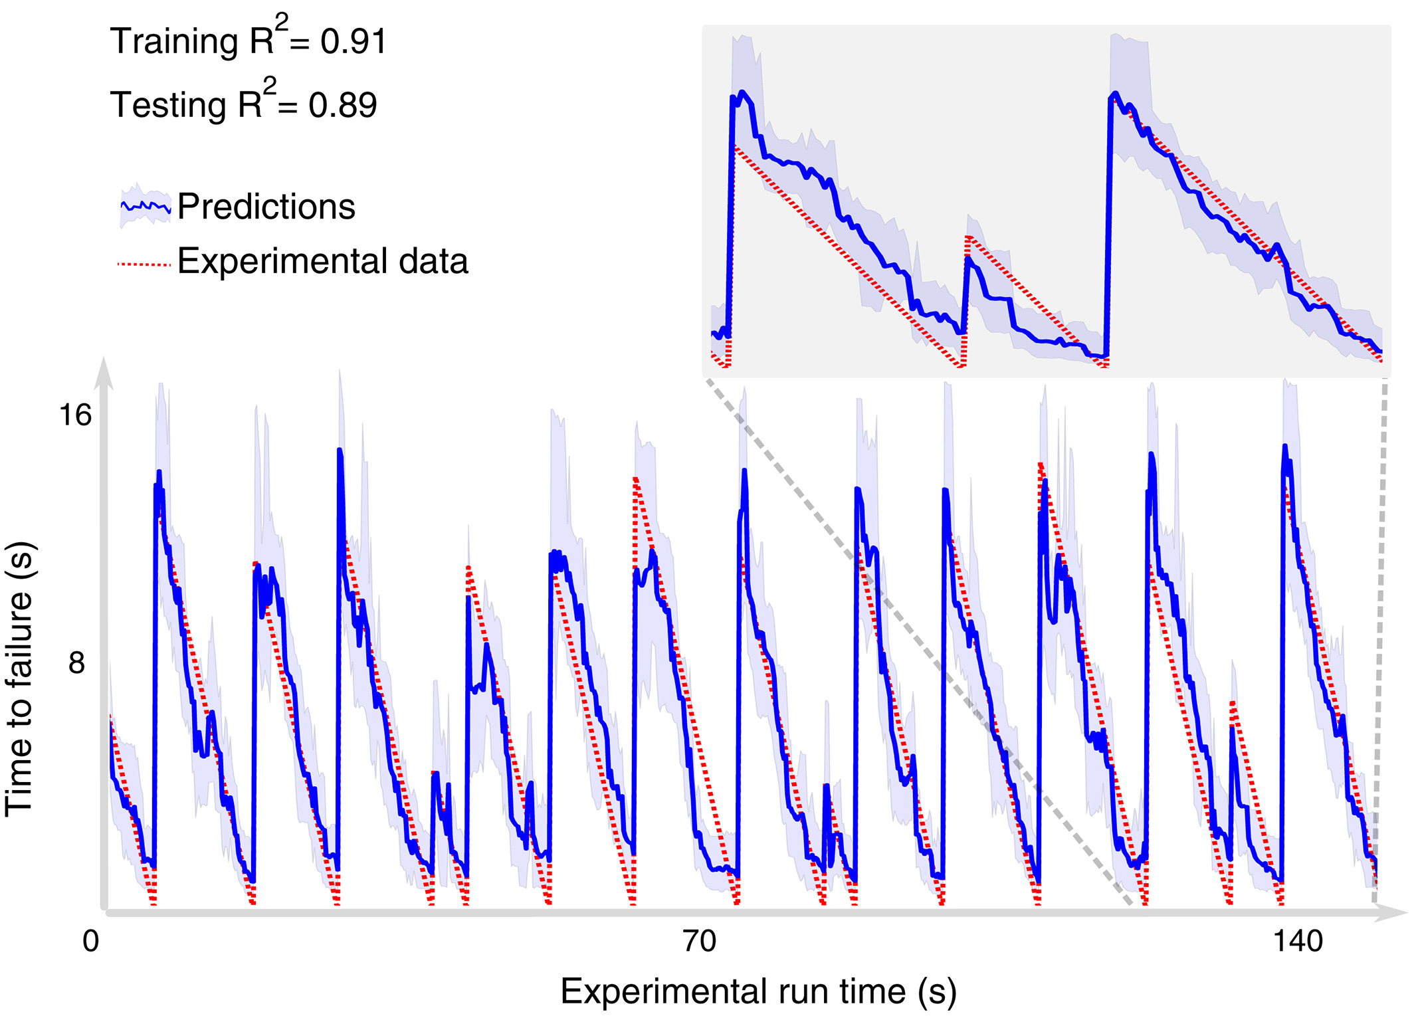
Source: Rouet-Leduc Bertrand, Hulbert Claudia, Lubbers Nicholas, Barros Kipton, Humphreys Colin J., JohnsonPaul A. (2017, July 15). Machine Learning Predicts Laboratory Earthquakes. Retrieved from https://doi.org/10.1002/2017GL074677

Slide 8
Advances in Technology
Improvement in the Instruments for Measuring Signals
Improvement in computing power to collect data

Slide 9
Los Alamos National Laboratory -
“we selected an experiment that exhibits a very aperiodic and more realistic behavior compared to the data we studied in our early work”.
“The data from this classic earthquake machine had never been studied using ML until our early efforts 3 years ago, and much remains to be explored and discovered.”

Slide 10
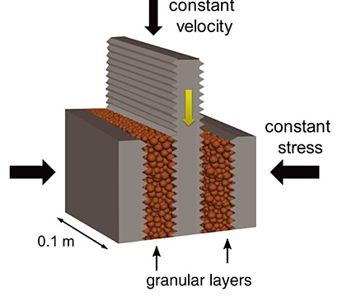
Lab Earthquake Simulation
LANL collected a high volume of more realistic and aperiodic data
Lab earthquakes occurring more irregularly

Slide 11
Problem Statement
Given a higher volume of more realistic and aperiodic earthquake failures (than LANL’s study); can we predict laboratory earthquakes?

Slide 12
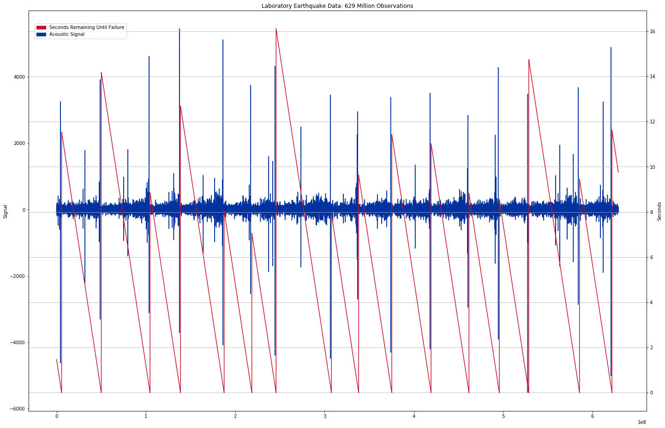
Data

Slide 13
Methodology
Predict using only acoustic signal data
Exclude historical recurrence interval
629,000,000 observations
Created additional statistical input from the acoustic data (variance, skewness, kurtosis…)
50/50 train test split

Slide 14
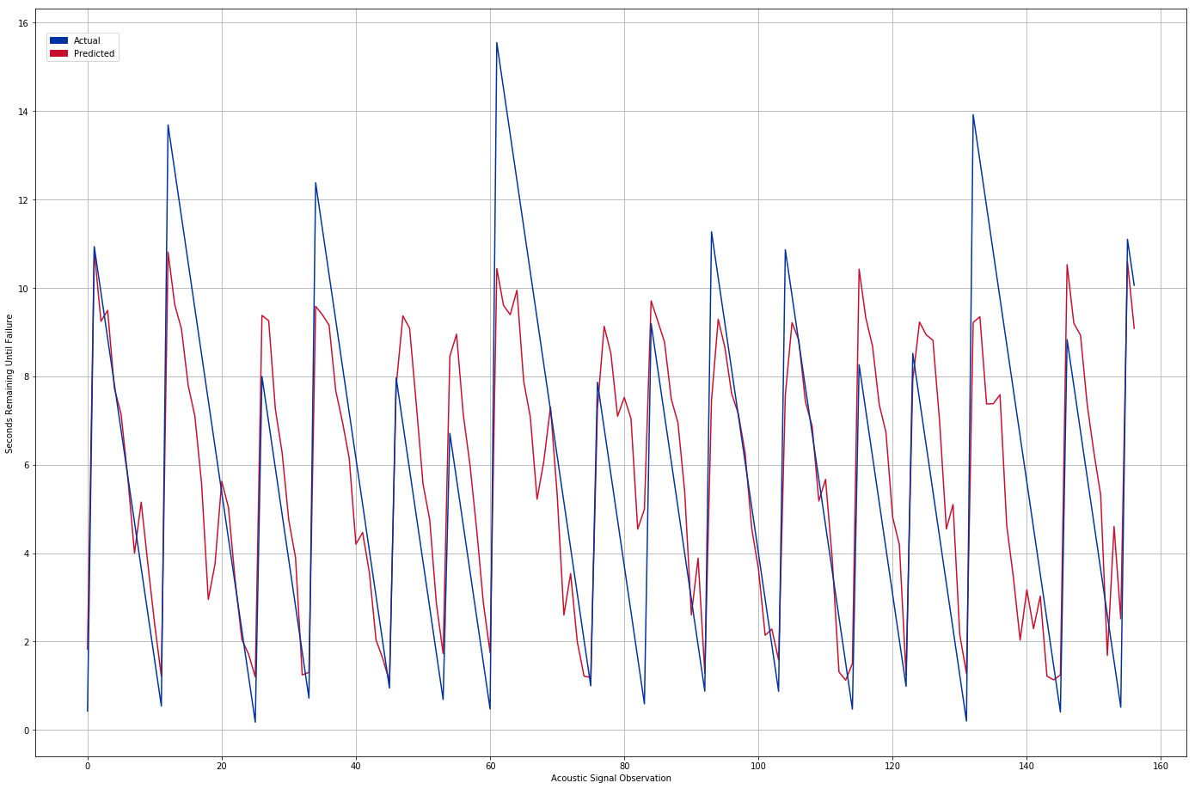
Results

Slide 15
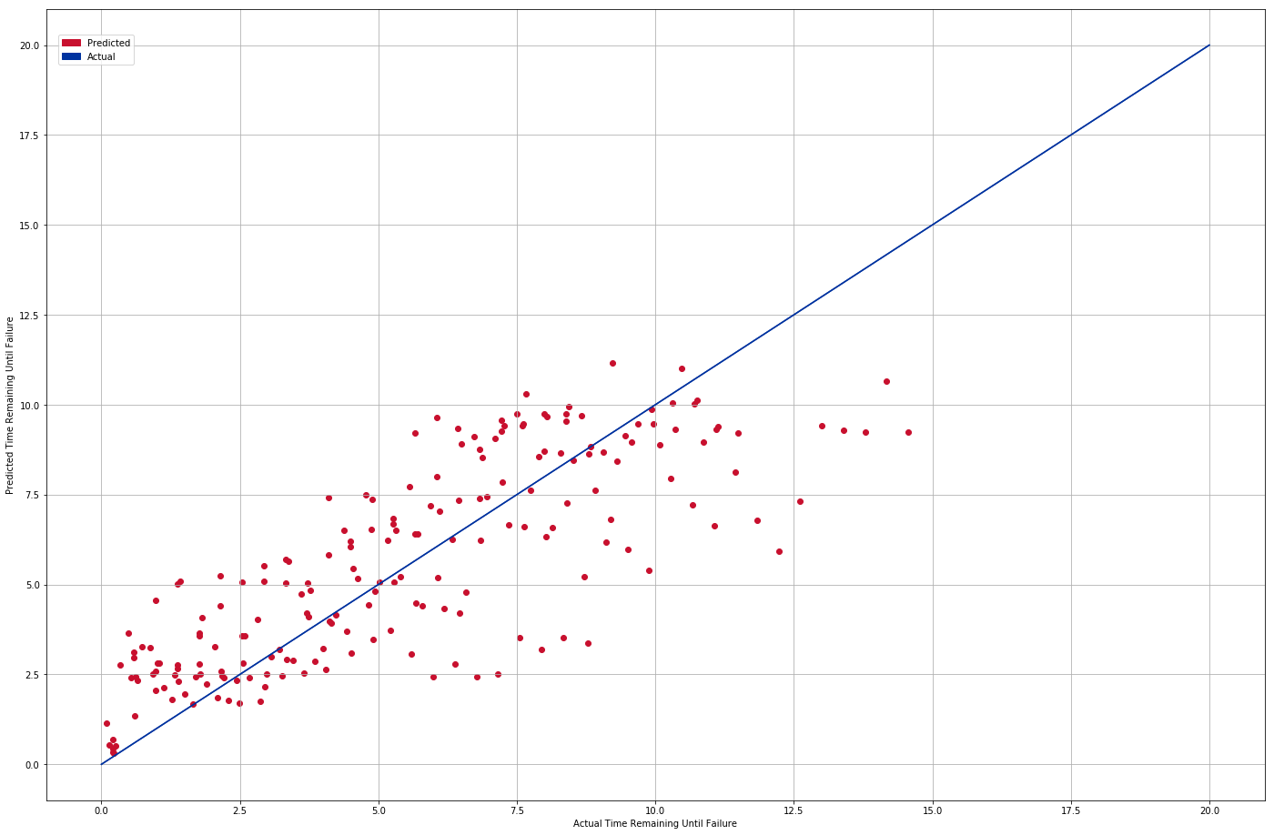
Results

Slide 16
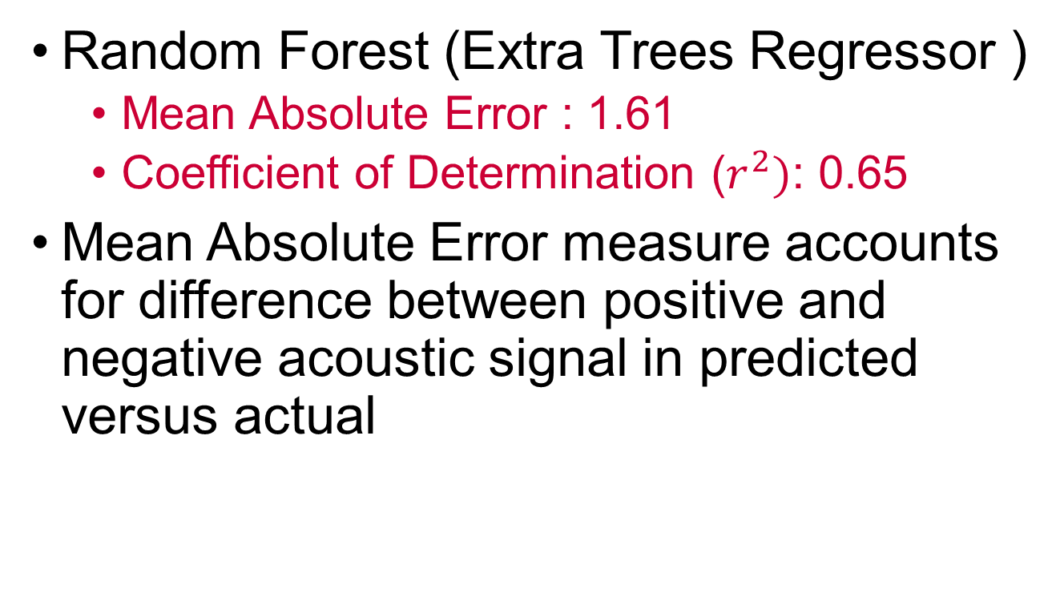
Results
Random Forest (Extra Trees Regressor )
Mean Absolute Error : 1.61
Coefficient of Determination ($r^{2})$: 0.65
Mean Absolute Error measure accounts for difference between positive and negative acoustic signal in predicted versus actual

Slide 17
Conclusion
The evidence suggests that given the more realistic data, Machine Learning can provide failure forecasts with 71 % accuracy
The results are encouraging but we are predicting at best 16 seconds in advance
The results should not be measured against the earlier LANL Study; the data is different

Slide 18
From Lab to Real World
“If this challenge is solved and the physics are ultimately shown to scale from the laboratory to the field, researchers will have the potential to improve earthquake hazard assessments that could save lives and billions of dollars in infrastructure.”
- Los Alamos National Laboratory, Geophysics Group

Slide 19
From Lab to Real World
The experiment closely mimics Earth faulting, so the same approach may work in predicting timing, but not size, of an earthquake. This approach could be applied to predict avalanches, landslides, failure of machine parts, and more
- Los Alamos National Laboratory, Geophysics Group

Slide 20
Ethical Considerations
If people believe us and we are wrong; bad things can happen
If people believe us and we are right; good and bad things can happen
Responsibility to inform the public about their results may conﬂict with their responsibility not to cause social disturbance

Slide 21
References
Bertrand Rouet-Leduc, Claudia Hulbert, Machine learning predicts laboratory earthquakes
Kaggle, R.: Lanl earthquake prediction
Ikari Matt J, Marone Chris, : Slip weakening as a mechanism for slow earthquakes
Baptiste Rousset, Roland Burgmann, M.C.: Slow slip events in the roots of the san andreas fault
USGS: What is an earthquake and what causes them to happen? (March 2019)
Rouet-Leduc, B.: Los Alamos machine learning discovers patterns that reveal earthquake fault behavior
Ayhan Sol, Halil Turan: The ethics of earthquake prediction. Volume 10, ​Issue 4​, pp 655–666 (December 2004)

